Slide 1
C# Advanced features
Feb 2016

Slide 2
Agenda
Automatic: type, property
Object & Collection initializer
Anonymous: type, method
Delegate & event, polymorphism
Reference
Miscellaneous

Slide 3
Automatic type & property
1

Slide 4
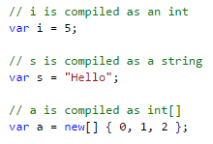
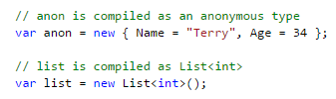
Automatic type inference
Implicitly Typed Local Variables

Slide 5
Questions
Is it like Javascript var? (Loosely typed, dynamic)
What is it actually?
What is the benefit?
Why would developer want to use it?
Actually, when to use and when not to use?

Slide 6
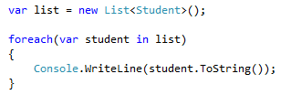
My best usage scenario
List declaration
List iteration

Slide 7
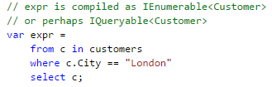
Later usage in this course
LINQ

Slide 8

Automatic property
OOP encapsulation rule
Never expose public fields, use property instead!
Better for logic adding later
No breaking changes! => Better maintenance
Properties can be databound, fields cannot!

Slide 9
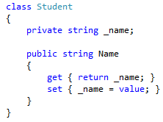
Equivalent
Whatever you write, the right code will always be generated! (Kind of similarity, not exactly)

Slide 10
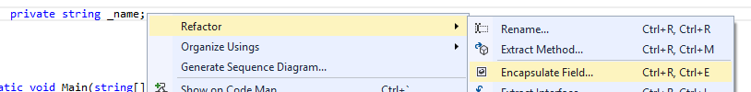
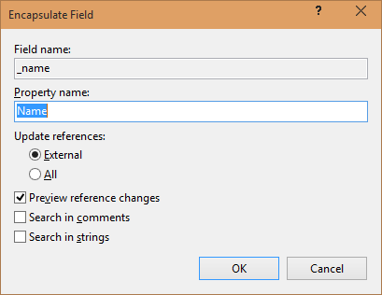
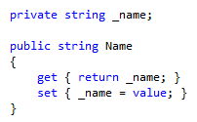
Have VS encapsulated for u
Using refactor feature
Notes:
Có nhiều ngữ cảnh để bao bọc lại thành phần của lớp: viết lại một lớp khác, đọc code của một developer khác, hồi xưa code nhanh để chạy giờ cần làm tốt hơn để dễ nâng cấp. Nhưng mà giờ có auto implemented properties rồi thì cũng ít khi cần phải làm như thế này lắm.

Slide 11
Read only property
Lúc trước
public string FirstName { get; private set; }
public string LastName { get; private set; }
Bản mới
public string FirstName { get; }
public string LastName { get; }

Slide 12
Object & Collection initializer
2

Slide 13


Object initializer
Old way to initialize
New and more convenient way to initialize

Slide 14
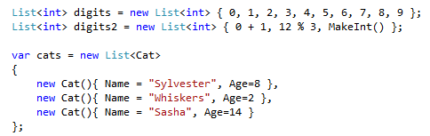
Collection initializer

Slide 15
Anonymous type & method
3

Slide 16
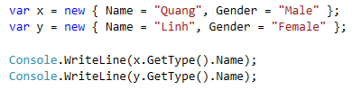


Things to consider
Same class?

Slide 17
Anonymous type
Usage scenario: purely for storing data (database access)

Slide 18
Delegate & event
4

Slide 19
Similarity
Function pointer in C++
Delegate: type of function pointer (the interface)

Slide 20
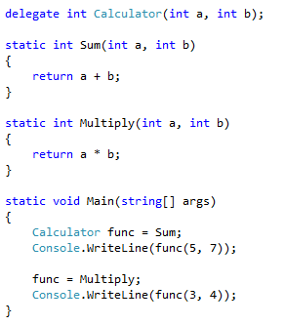
Delegate example

Slide 21
Event
Like Win32 API callback
Register function that will be called when an event happen

Slide 22
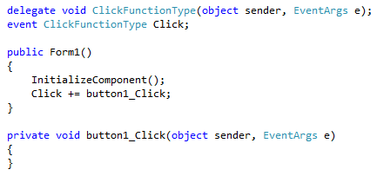
Event example

Slide 23
Usage scenario
Create processing framework
Generalization

Slide 24


Lambda expression

Slide 25
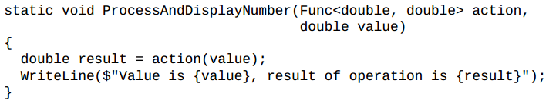
Func<in T, out TResult>

Slide 26
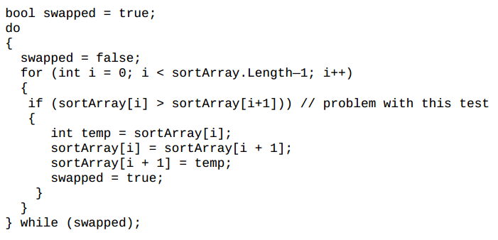
Example – Sort method
How to make it work with any type rather than int?

Slide 27

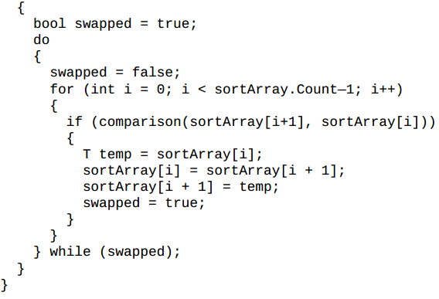
Solution

Slide 28
Reference
5

Slide 29
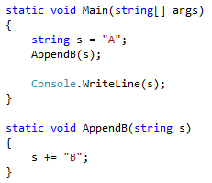
Question 1: result?
Notes:
Đáp án: “A”

Slide 30
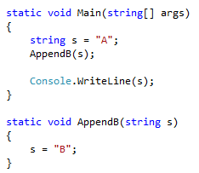
Question 2: result
Notes:
Đáp án: “A” (như cũ)

Slide 31
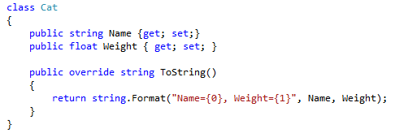
Given a Cat class

Slide 32
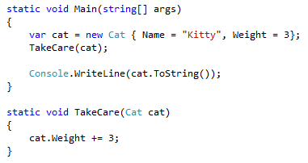
Question 3: result?
Notes:
Chú ý trọng lượng của con mèo là 6!!!!, ta vẫn có con mèo cũ

Slide 33
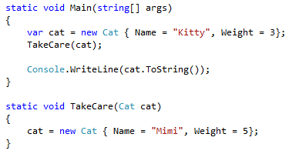
Question 4: result?
Do we still have the old cat?

Slide 34
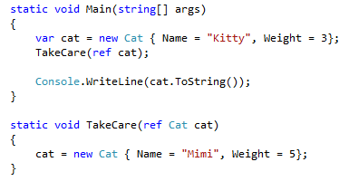
Question 5: result?
Do we still have the old cat?

Slide 35
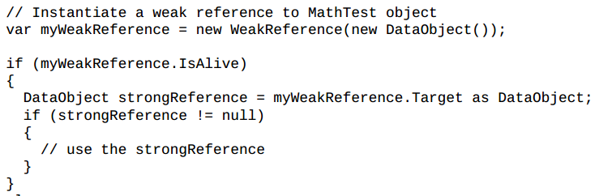
Weak reference

Slide 36
Miscellaneous

Slide 37
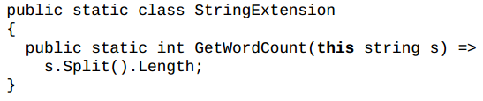
Extension methods
String fox = “fox”; fox.GetWordCount();

Slide 38
High performance stack array
Indexer just like C++ array
pDecimals[0] = * pDecimals
pDecimals[1] = * (pDecimals + 1)
Be carefull of this type of unsafe code!
Cannot free the memory
Automatically delete after method ends

Slide 39
Generics vs ArrayList
Classes & Methods independent of contained types
List, Queue, Stack, Array…
Can be Delegates, Lambdas, Events
Vs ArrayList

Slide 40
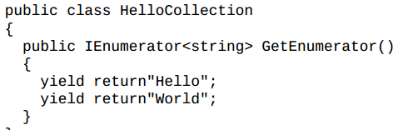
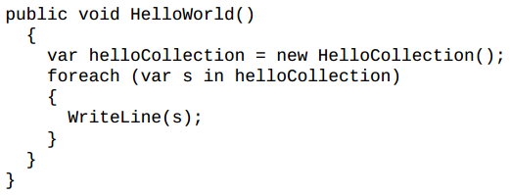
yield return
yield break: stop iteration

Slide 41
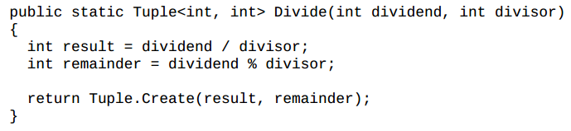
Tuple

Slide 42
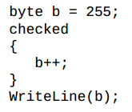
checked & unchecked
checked: forced overflow checking, throw OverflowException

Slide 43
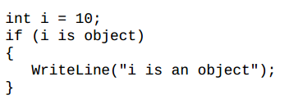
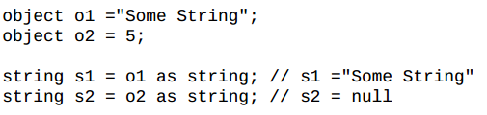
is & as operator
is: checking type
as: safe type casting

